Slide 1
Analysis Kill Bots Process in Defending from Distributed Denial of Service Attack using Bloom Filter Data Structure
Ian Febrian - 209115870

Slide 2
Key Point
Background
Objective
Scope
Distributed Denial of Service
Apache Development
Bloom Filter
Kill Bots
Result System Testing
Conclusion

Slide 3
Background
Nowadays, Denial of Service attack has been launched by botnet.
Flash Crowd from Distributed Denial of Service that mimic legitimate user behavior is hard enough to prevent.
There is no module found to prevent a Flash Crowd Attack in Apache Web Server.
Notes:
Jaman Sekarang, penyerangan menggunakan metode Denial of Service dilakukan oleh botnet (Botnet adalah sebutan bagi komputer yang telah diretas dan siap digunakan untuk menyerang sebuah korban) [Dengan adanya botnet serangan Denial of Service pun berubah dari satu komputer sebagai penyerang, menjadi ratusan komputer yang digunakan untuk menyerang, yang disebut dengan Distributed Denial of Service.
Cukup susahnya serangan Flash Crowd dari DDoS di mana serangannya meniru perilaku pengguna yang sah untuk dihentikan
Belum ditemukannya modul yang digunakan untuk mencegah serangan Flash Crowd pada Apache Web Server

Slide 4
Objective
To analyze the authentication process of Kill Bots
To analyze what is Distributed Denial of Service and it’s type
Learn more about what is Bloom Filter data structure
Learn how to make and develop a apache module

Slide 5
Scope
The media to implement Kill Bots is Apache Web Server v1.7.1
Bloom filter is implemented in basic structure
Distributed Denial of Service Flash Crowd attack is used
Attack will be launch at port 80
Local Area Network is used to test the performance of Kill Bots
Notes:
Alasan mengapa memakai web server 1.7.1, Karena dalam pengembangan pada versi web server 1.7.1 dapat digunakan baik pada versi sebelumnya dan versi 2.0 ke atas.
Mengapa tidak memakai 2.0, karena pengembangan pada versi 2.0 atau 2.0 ke atas, mempunyai banyak kemungkinan fungsi yang digunakan telah deprecated.

Slide 6
What is Denial of Service?
The goal is to make server busy, or even overload
Use single computer
Make a connection from random or specified port

Slide 7
How about the distributed part?
Same goal, but getting stronger
One computer as a brain, and the other one are the worker
Untraceable main artist
Use a lot of worker
The quantity is based on how fast the worm spreads

Slide 8
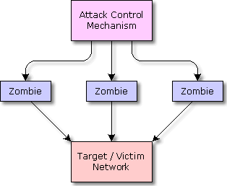
Distributed Denial of Service

Slide 9

Apache Development

Slide 10
Apache Web Server
Development of Apache began in early 1995 after work on the NCSA code stalled by Rob McCool.
NCSA is National Center for Supercomputing Applications in University of Illinois, Urbana-Champaign.
In 2009, it became the first web server software to serve more than 100 million websites.
Apache supports a variety of features, many implemented as compiled modules which extend the core functionality
Apache provides a variety of Multi Processing Modules (MPMs).
Notes:
- MPM = which allow Apache to run in a process-based, hybrid (process and thread) or event-hybrid mode, to better match the demands of each particular infrastructure

Slide 11
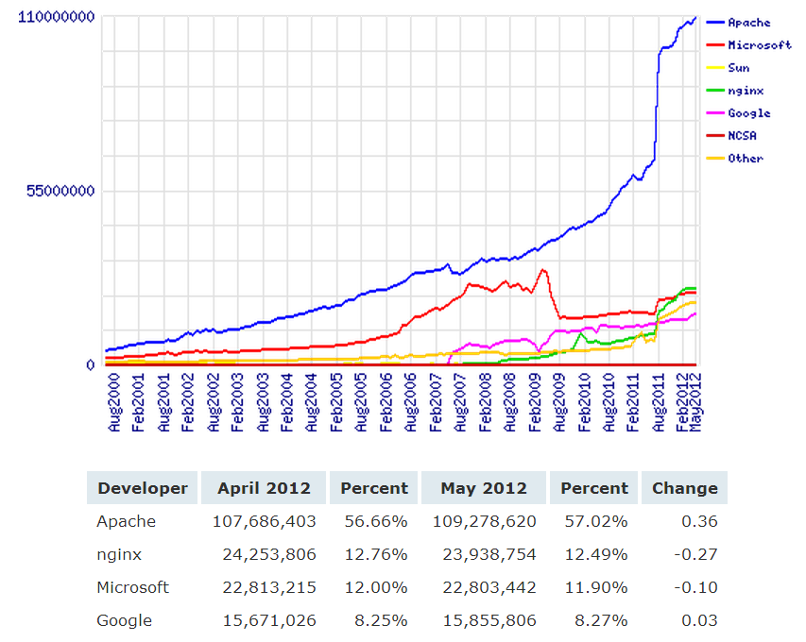
Apache Web Server
Notes:
- Data Statistik Web Server yang Aktif Agustus 2000 – Mei 2012
- Sumber data dari NetCraft

Slide 12
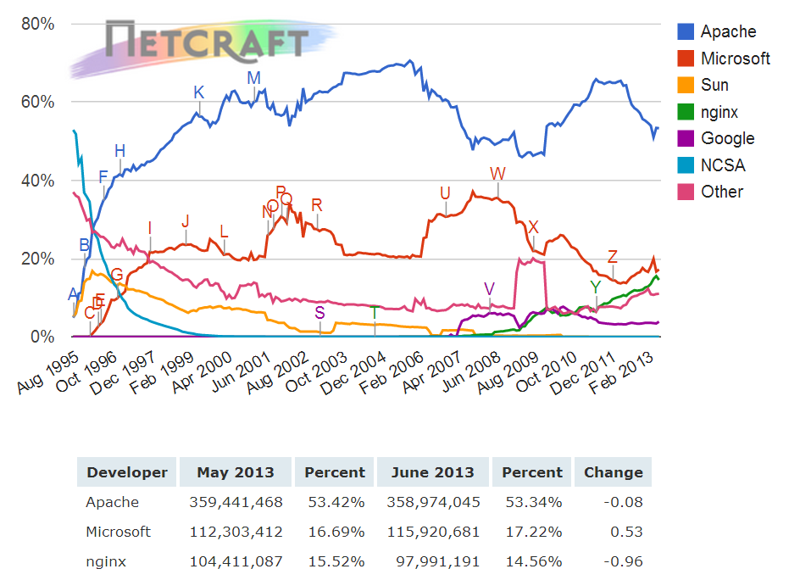
Apache Web Server
Notes:
- Data Statistik Web Server yang Aktif Agustus 1995 – Feb 2013
- Sumber data dari NetCraft

Slide 13
Apache Development
Use an extra package (devel pack)
Only at UNIX Based Operating System
C is the main language
Perl is the second main language
Has own compiler called APXS (APache eXtenSion tool)

Slide 14
How to compile and load a module to Apache?
Use a terminal (UNIX) or a command prompt (Windows)
# sudo [apache folder]/bin/apxs –i –a –c mod_example.c
-i -> This indicates the installation operation and installs one or more dynamically shared objects into the server's modules directory.
-a -> This activates the module by automatically adding a corresponding LoadModule line to Apache's httpd.conf configuration file, or by enabling it if it already exists.
-c -> This indicates the compilation operation. The result of this operation is .o, .a, and .so file.
LoadModule killbots_module modules/mod_killbots.so
Notes:
- LoadModule killbots_module modules/mod_killbots.so

Slide 15
What is Bloom Filter?
Created by Burton Howard Bloom in 1970
Bloom Filter is a space-efficient probabilistic data structure that is used to test whether an element is a member of a set.
There are two feed back from Bloom filter, False Positive and False Negative
False Positive matches are possible, but False Negative are not.
Elements can be added to the set, but not removed.
The more elements that are added to the set, the larger the probability of false positives.

Slide 16
Calculate Bloom Filter
Equation for calculate 0 bit when n elements had arrived
q is size of bit array, and k is number of hash function

Slide 17
Calculate Bloom Filter
Equation for False Positive result
p is the result from equation for calculate 0 bit when n elements had arrived, and k is number of hash function

Slide 18
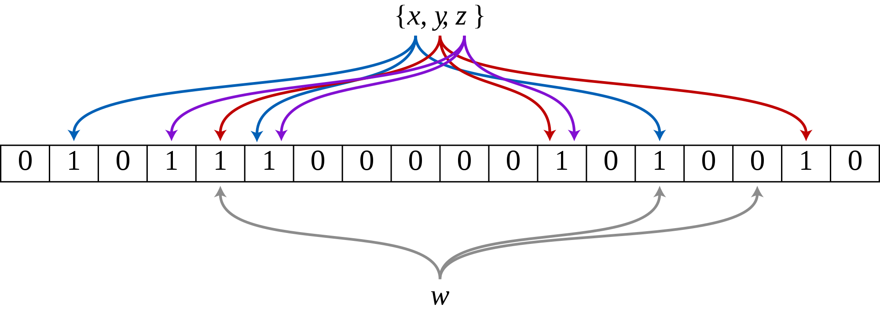
Bloom Filter
Notes:
An example of a Bloom filter, representing the set {x, y, z}.
The colored arrows show the positions in the bit array that each set element is mapped to.
The element w is not in the set {x, y, z}, because it hashes to one bit-array position containing 0.
For this figure, m=18 and k=3.

Slide 19
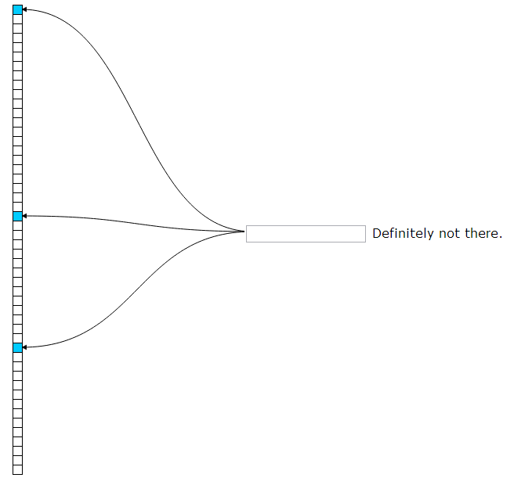

Bloom Filter Example
Notes:
The bloom filter essentially consists of a bit vector of length m, represented by the central column.
To add an item to the bloom filter, we feed it to k different hash functions and set the bits at the resulting positions.
In this example, m is 50 and k is 3. Note that sometimes the hash functions produce overlapping positions, so less than kpositions may be set.
To test if an item is in the filter, again we feed it to the k hash functions. This time, we check to see if any of the bits at these positions are not set. If any are not set, it means the item is definitely not in the set. Otherwise, it is probably in the set.
Fowler–Noll–Vo Hash Function 3x

Slide 20
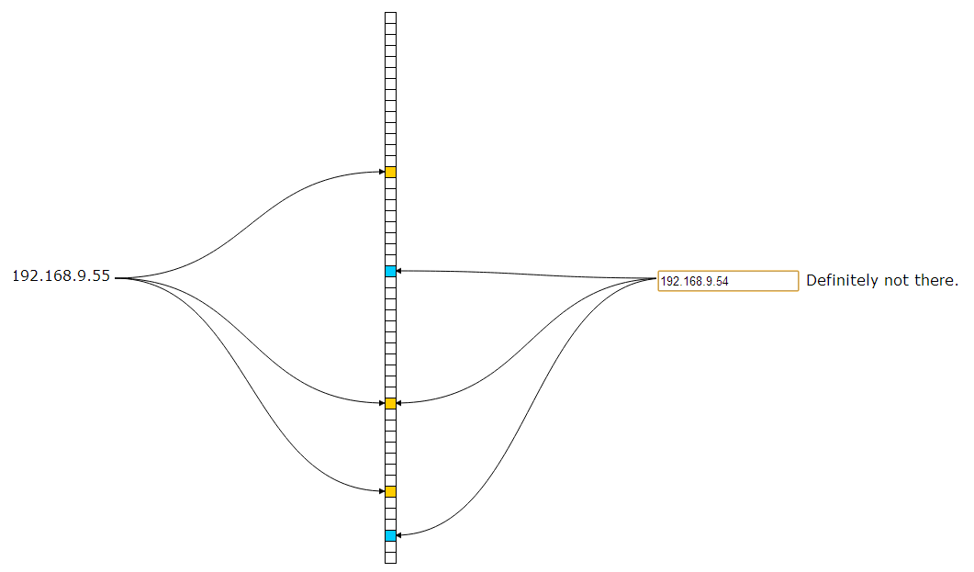
Bloom Filter Example

Slide 21
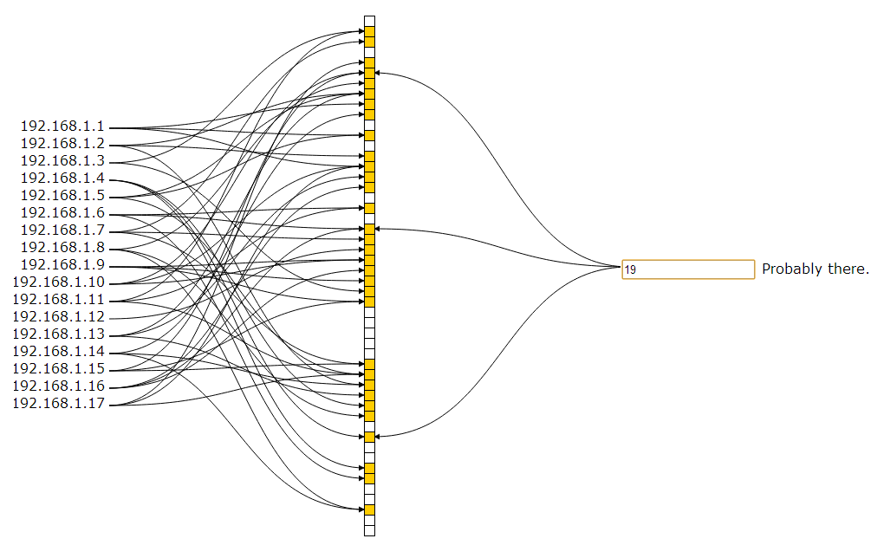
Bloom Filter Example

Slide 22
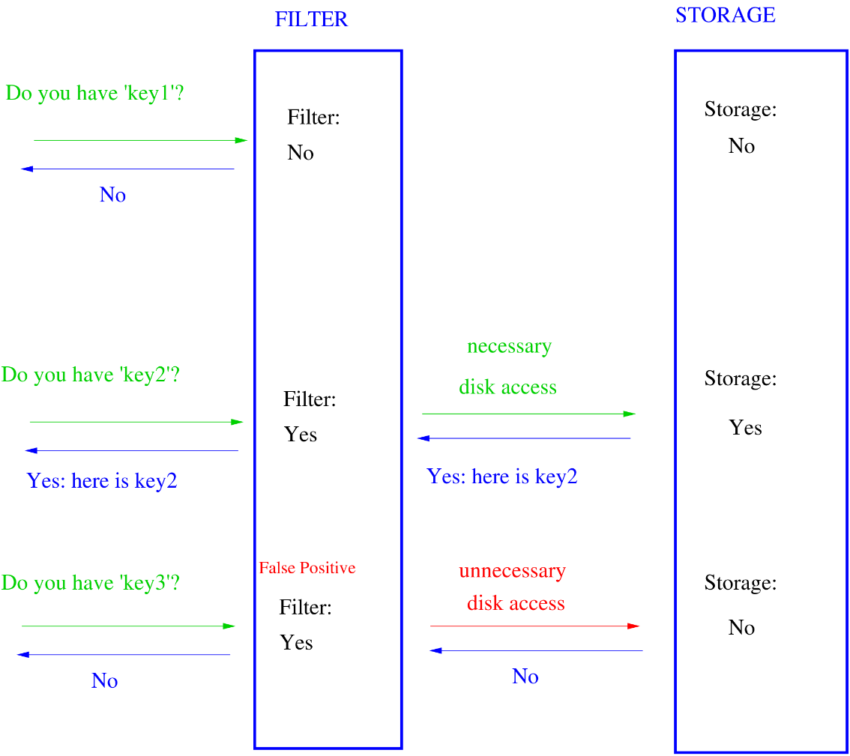
Bloom in The Application
Notes:
pertama, jika filter tidak menemukan elemen yang dicari
Kedua, jika filter menemukan, tetapi tempat penyimpanan tidak menemukan
Ketiga, jika filter menemukan dam tempat penyimpanan menemukan

Slide 23
Kill-Bots
Surviving BotNet
Attacks that Mimic
Flash Crowd

Slide 24


What is Kill Bots?
Authentication Process to define whether it is zombie or legitimate user
OR

Slide 25
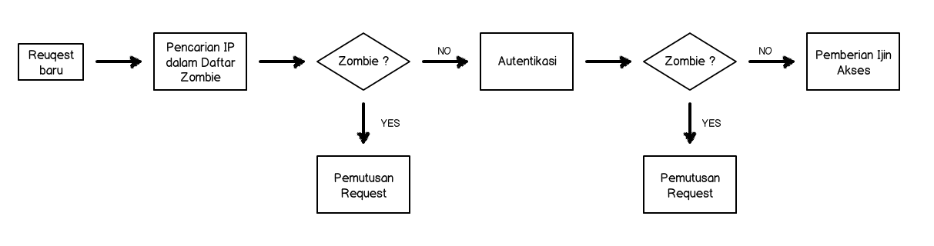
Kill Bots Architecture

Slide 26
Transition Status
LOAD >= K₁
NORMAL
SUSPECTED
LOAD <= K₂ < K₁

Slide 27
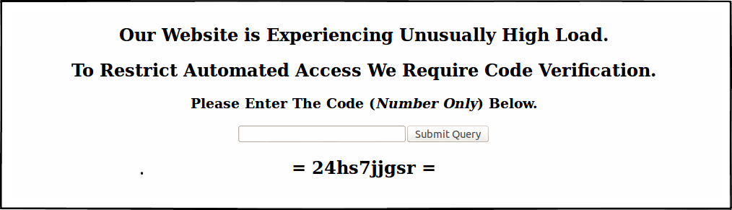
Captcha
Notes:
- Jelaskan tentang alur setelah menjawab captcha (benar atau salah)

Slide 28

Secret Token

Slide 29
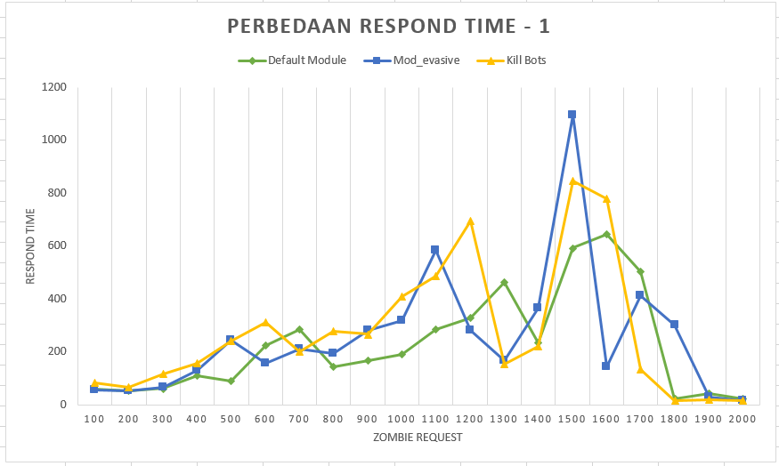
Performance Testing
Number of Computer used: 10
Number of Thread each Computer: 20
Number of Request each thread: 10
Total request: 2.000 (200 request / second)

Slide 30
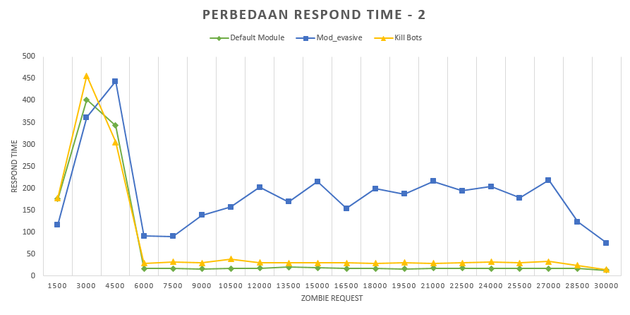
Performance Testing
Number of Computer used: 10
Number of Thread each Computer: 20
Number of Request each thread: 150
Total request: 30.000 (200 request / second)

Slide 31
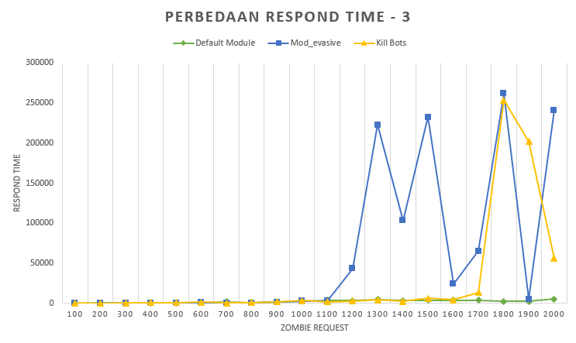
Performance Testing
Number of Computer used: 10
Number of Thread each Computer: 100
Number of Request each thread: 2
Total request: 2.000 (200 request / second)

Slide 32
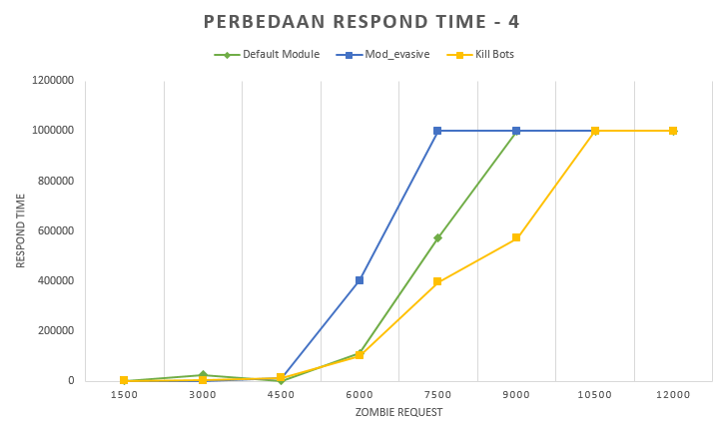
Performance Testing
Number of Computer used: 10
Number of Thread each Computer: 1.500
Number of Request each thread: 2
Total request: 30.000 (15.000 request / second)

Slide 33
Conclusion
The integrated module makes Apache module development is easy to learn.
Multi Processing Module (MPM) make Apache run faster and tidy up the process flow.
Differences whether zombie and the legitimate user is based on their behaviour to solve the test.
Kill Bots takes more time than default server while serving a normal environment.
Kill Bots can serve more request than default server when attack wave has arrived.

Slide 34
End of Presentation
Thank You

